Slide 1
Foundations of Cryptography Kerckhoff’s principle, shift cipher, brute-force attack, sufficient key space principle, substitution cipher, letter frequency attack, Vigenère cipher
LiangFeng Zhang
zhanglf@shanghaitech.edu.cn
SIST, ShanghaiTech, 2019F

Slide 2

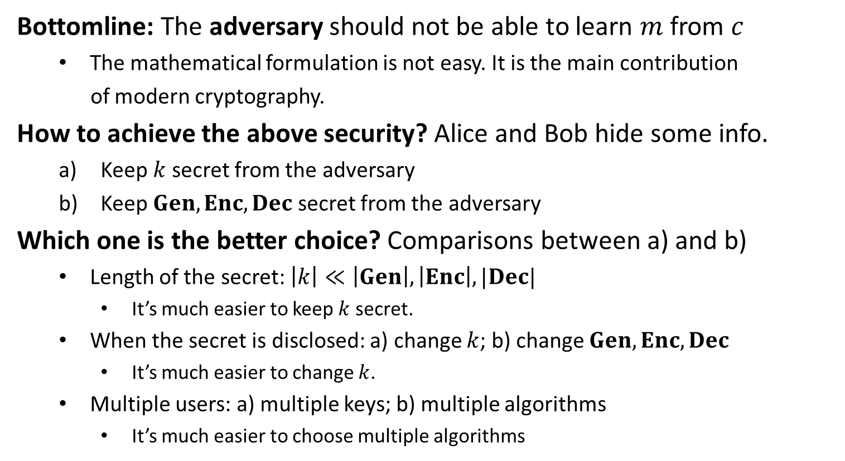
Security of $PrivKE$
Bottomline: The adversary should not be able to learn $m$ from $c$
The mathematical formulation is not easy. It is the main contribution
of modern cryptography.
How to achieve the above security? Alice and Bob hide some info.
Keep $k$ secret from the adversary
Keep $Gen, Enc, Dec$ secret from the adversary
Which one is the better choice? Comparisons between a) and b)
Length of the secret: $\left|k\right|≪\left|Gen\right|, \left|Enc\right|, |Dec|$
It’s much easier to keep $k$ secret.
When the secret is disclosed: a) change $k$; b) change $Gen, Enc, Dec$
It’s much easier to change $k$.
Multiple users: a) multiple keys; b) multiple algorithms
It’s much easier to choose multiple algorithms
better choice!

Slide 3
Kerckhoff’s Principle
PRINCIPLE: The cipher method must not be required to be secret, and
it must be able to fall into the hands of the enemy without
inconvenience.
Security should solely rely on the secrecy of the key
By Kerckhoff, 19th century
REMARK: Cryptographic designs (algorithms) can be made public
It’s easy to find the weakness of a design and so make improvement. Eventually, a really strong design will be obtained.
However, many designs in national security remain not public

Slide 5

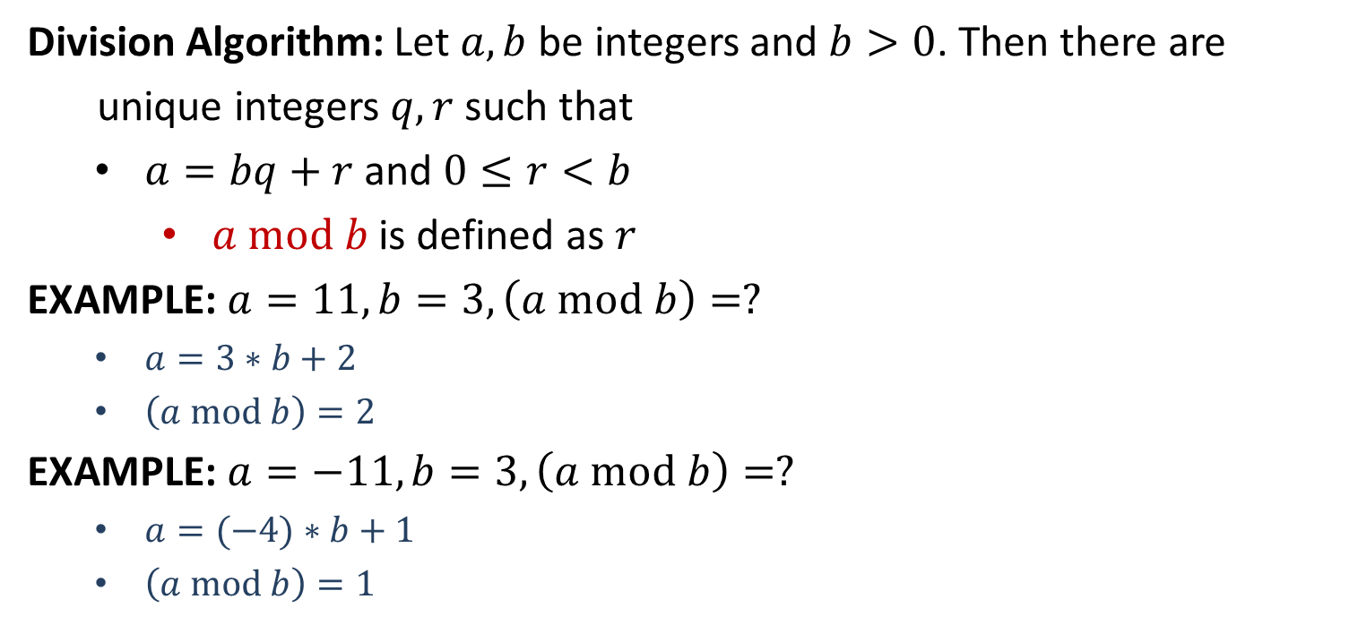
$$mod$$
Division Algorithm: Let $a,b$ be integers and $b>0$. Then there are
unique integers $q,r$ such that
$a=bq+r$ and $0≤r<b$
$a mod b$ is defined as $r$
EXAMPLE: $a=11, b=3, \left(a mod b\right)=?$
$a=3∗b+2$
$\left(a mod b\right)=2$
EXAMPLE: $a=−11, b=3, \left(a mod b\right)=?$
$a=(−4)∗b+1$
$\left(a mod b\right)=1$

Slide 6



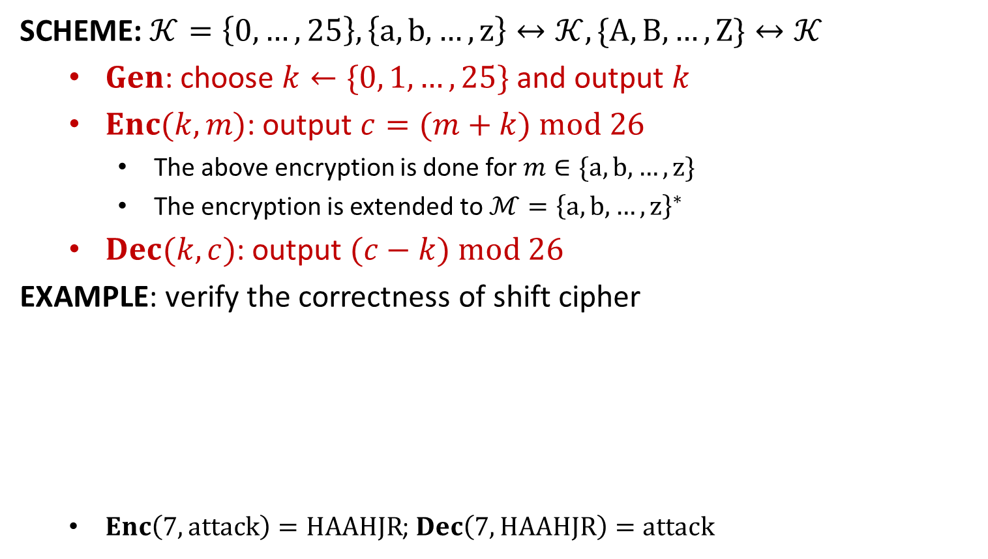












Shift Cipher
SCHEME: $𝒦=\left\{0,…,25\right\},\left\{a,b,…,z\right\}↔𝒦, \{A,B,…,Z\}↔𝒦$
$Gen$: choose $k←\{0, 1,…, 25\}$ and output $k$
$Enc(k,m)$: output $c=(m+k) mod 26$
The above encryption is done for $m∈\{a,b,…,z\}$
The encryption is extended to $ℳ={\left\{a,b,…,z\right\}}^{∗}$
$Dec(k,c)$: output $(c−k) mod 26$
EXAMPLE: verify the correctness of shift cipher
$Enc\left(7,attack\right)=HAAHJR$; $Dec\left(7, HAAHJR\right)=attack$
∙∙∙∙∙∙
$$x$$
$$y$$
$$z$$
$$a$$
$$b$$
$$c$$
∙∙∙∙∙∙
$$u$$
∙∙∙∙∙∙
∙∙∙∙∙∙
$$E$$
$$F$$
$$G$$
$$H$$
$$I$$
$$J$$
∙∙∙∙∙∙
$$B$$
∙∙∙∙∙∙
$$k=7$$

Slide 7
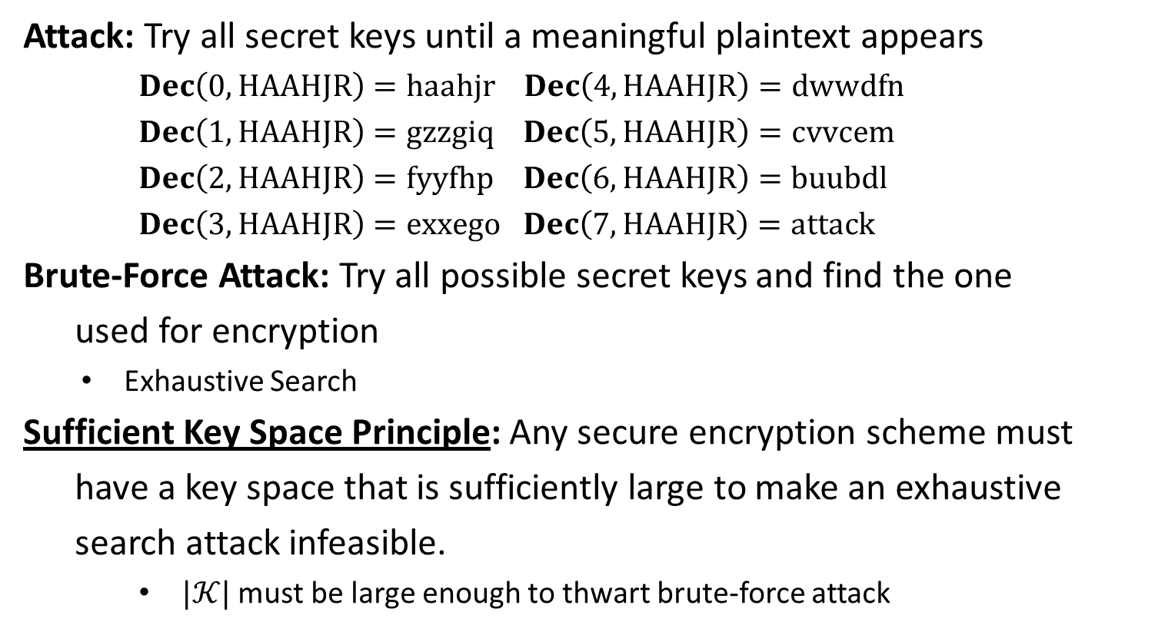
Security
Attack: Try all secret keys until a meaningful plaintext appears
$Dec\left(0,HAAHJR\right)=haahjr$ $Dec\left(4,HAAHJR\right)=dwwdfn$
$Dec\left(1,HAAHJR\right)=gzzgiq$ $Dec\left(5,HAAHJR\right)=cvvcem$
$Dec\left(2,HAAHJR\right)=fyyfhp$ $Dec\left(6,HAAHJR\right)=buubdl$
$Dec\left(3,HAAHJR\right)=exxego$ $Dec\left(7,HAAHJR\right)=attack$
Brute-Force Attack: Try all possible secret keys and find the one
used for encryption
Exhaustive Search
Sufficient Key Space Principle: Any secure encryption scheme must
have a key space that is sufficiently large to make an exhaustive
search attack infeasible.
$|𝒦|$ must be large enough to thwart brute-force attack

Slide 9
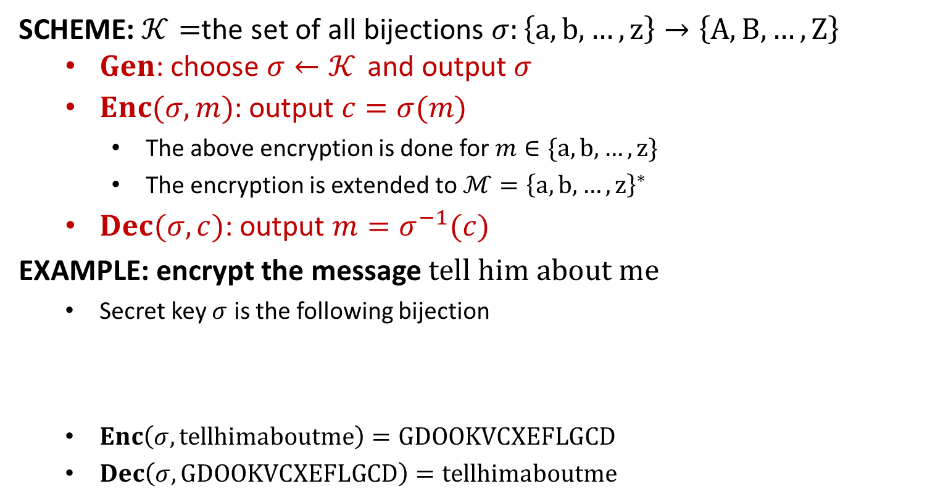
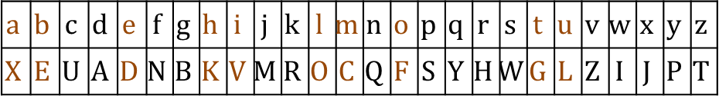
Substitution Cipher
SCHEME: $𝒦=$the set of all bijections $σ:\left\{a,b,…,z\right\}→\left\{A,B,…,Z\right\}$
$Gen$: choose $σ←𝒦$ and output $σ$
$Enc(σ,m)$: output $c=σ(m)$
The above encryption is done for $m∈\{a,b,…,z\}$
The encryption is extended to ${ℳ=\left\{a,b,…,z\right\}}^{∗}$
$Dec(σ,c)$: output $m=σ^{−1}(c)$
EXAMPLE: encrypt the message $tell him about me$
Secret key $σ$ is the following bijection
$Enc\left(σ,tellhimaboutme\right)=GDOOKVCXEFLGCD$
$Dec\left(σ,GDOOKVCXEFLGCD\right)=tellhimaboutme$
$$a$$ | $$b$$ | $$c$$ | $$d$$ | $$e$$ | $$f$$ | $$g$$ | $$h$$ | $$i$$ | $$j$$ | $$k$$ | $$l$$ | $$m$$ | $$n$$ | $$o$$ | $$p$$ | $$q$$ | $$r$$ | $$s$$ | $$t$$ | $$u$$ | $$v$$ | $$w$$ | $$x$$ | $$y$$ | $$z$$
$$X$$ | $$E$$ | $$U$$ | $$A$$ | $$D$$ | $$N$$ | $$B$$ | $$K$$ | $$V$$ | $$M$$ | $$R$$ | $$O$$ | $$C$$ | $$Q$$ | $$F$$ | $$S$$ | $$Y$$ | $$H$$ | $$W$$ | $$G$$ | $$L$$ | $$Z$$ | $$I$$ | $$J$$ | $$P$$ | $$T$$

Slide 10
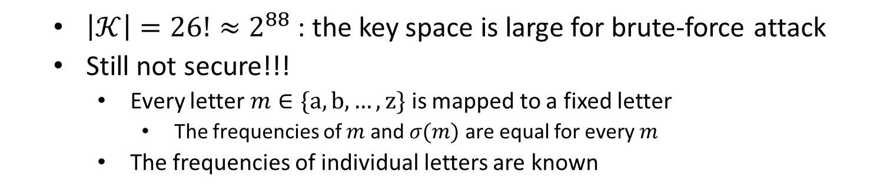
Security
$\left|𝒦\right|=26!≈2^{88}$ : the key space is large for brute-force attack
Still not secure!!!
Every letter $m∈\{a,b,…,z\}$ is mapped to a fixed letter
The frequencies of $m$ and $σ(m)$ are equal for every $m$
The frequencies of individual letters are known

Slide 11
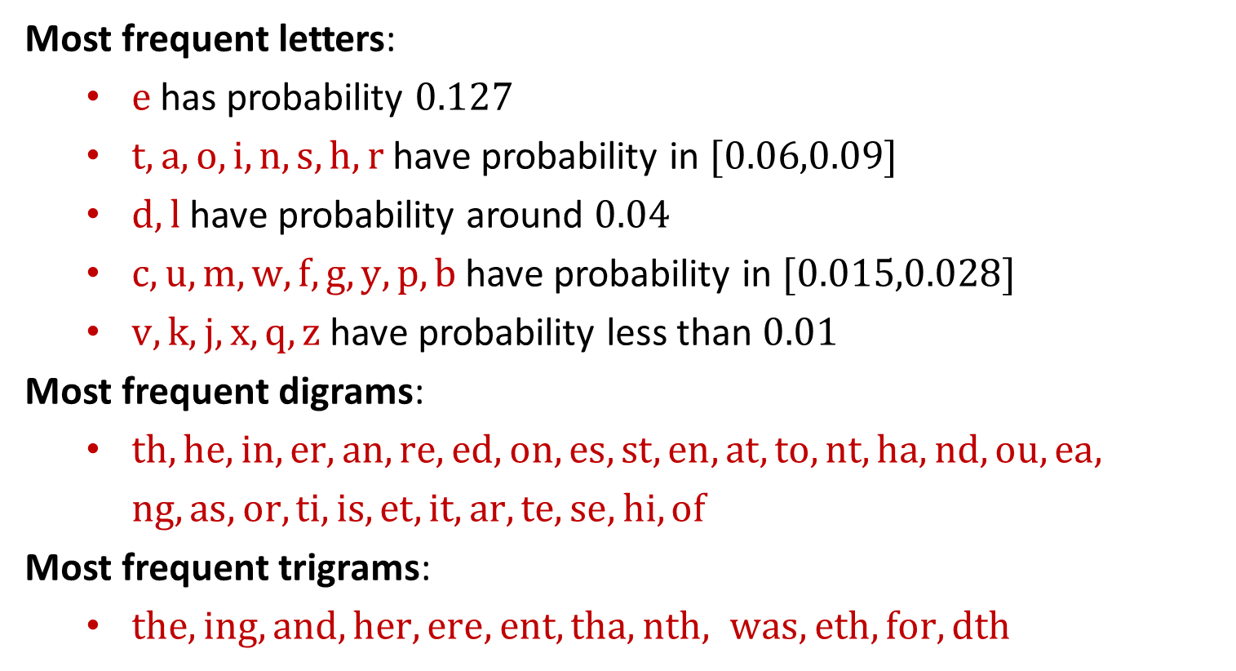
Letter Frequency Attack
Most frequent letters:
$e$ has probability $0.127$
$t,a,o,i,n,s,h,r$ have probability in $[0.06,0.09]$
$d,l$ have probability around $0.04$
$c,u,m,w,f,g,y,p,b$ have probability in $[0.015,0.028]$
$v,k,j,x,q,z$ have probability less than $0.01$
Most frequent digrams:
$th,he,in,er, an, re, ed,on, es, st, en,at, to,nt, ha, nd, ou, ea,$
$ng, as, or, ti, is, et, it, ar, te, se, hi, of$
Most frequent trigrams:
$the, ing,and, her, ere, ent, tha, nth, was, eth, for, dth$

Slide 12
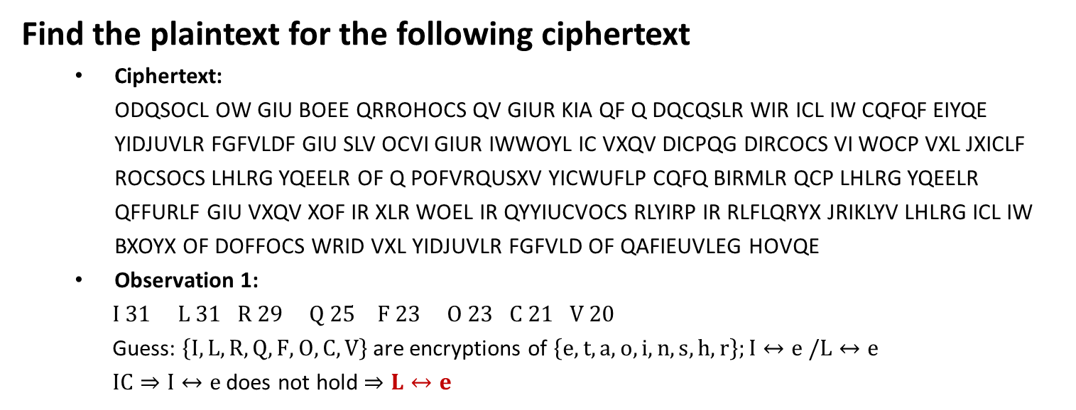
Example
Find the plaintext for the following ciphertext
Ciphertext: ODQSOCL OW GIU BOEE QRROHOCS QV GIUR KIA QF Q DQCQSLR WIR ICL IW CQFQF EIYQE YIDJUVLR FGFVLDF GIU SLV OCVI GIUR IWWOYL IC VXQV DICPQG DIRCOCS VI WOCP VXL JXICLF ROCSOCS LHLRG YQEELR OF Q POFVRQUSXV YICWUFLP CQFQ BIRMLR QCP LHLRG YQEELR QFFURLF GIU VXQV XOF IR XLR WOEL IR QYYIUCVOCS RLYIRP IR RLFLQRYX JRIKLYV LHLRG ICL IW BXOYX OF DOFFOCS WRID VXL YIDJUVLR FGFVLD OF QAFIEUVLEG HOVQE
Observation 1:
$I 31 L 31 R 29 Q 25 F 23 O 23 C 21 V 20$
Guess: $\left\{I,L,R,Q,F,O,C,V\right\}$ are encryptions of $\left\{e,t,a,o,i,n,s,h,r\right\};I↔e /L↔e$
$IC⇒I↔e$ does not hold $⇒L↔e$

Slide 13
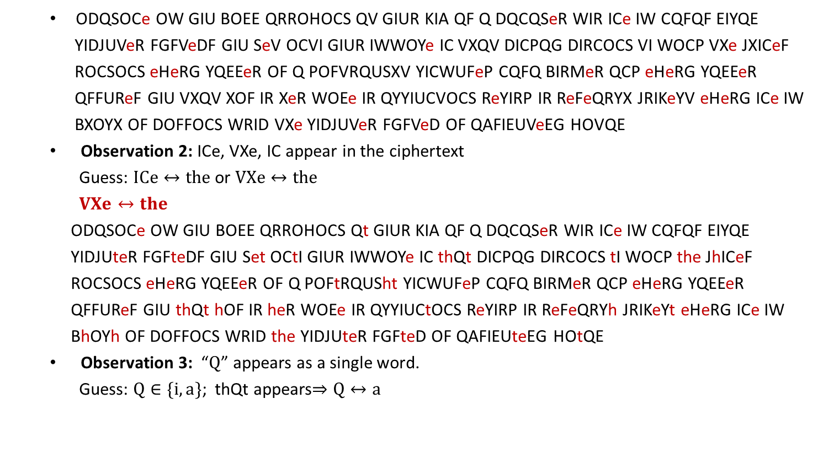
Example
ODQSOCe OW GIU BOEE QRROHOCS QV GIUR KIA QF Q DQCQSeR WIR ICe IW CQFQF EIYQE
YIDJUVeR FGFVeDF GIU SeV OCVI GIUR IWWOYe IC VXQV DICPQG DIRCOCS VI WOCP VXe JXICeF
ROCSOCS eHeRG YQEEeR OF Q POFVRQUSXV YICWUFeP CQFQ BIRMeR QCP eHeRG YQEEeR
QFFUReF GIU VXQV XOF IR XeR WOEe IR QYYIUCVOCS ReYIRP IR ReFeQRYX JRIKeYV eHeRG ICe IW
BXOYX OF DOFFOCS WRID VXe YIDJUVeR FGFVeD OF QAFIEUVeEG HOVQE
Observation 2: ICe, VXe, IC appear in the ciphertext
Guess: $ICe↔the$ or $VXe↔the$
$VXe↔the$
ODQSOCe OW GIU BOEE QRROHOCS Qt GIUR KIA QF Q DQCQSeR WIR ICe IW CQFQF EIYQE
YIDJUteR FGFteDF GIU Set OCtI GIUR IWWOYe IC thQt DICPQG DIRCOCS tI WOCP the JhICeF
ROCSOCS eHeRG YQEEeR OF Q POFtRQUSht YICWUFeP CQFQ BIRMeR QCP eHeRG YQEEeR
QFFUReF GIU thQt hOF IR heR WOEe IR QYYIUCtOCS ReYIRP IR ReFeQRYh JRIKeYt eHeRG ICe IW
BhOYh OF DOFFOCS WRID the YIDJUteR FGFteD OF QAFIEUteEG HOtQE
Observation 3: “$Q$” appears as a single word.
Guess: $Q∈\{i,a\}$; thQt appears$⇒Q↔a$

Slide 14
Example
ODaSOCe OW GIU BOEE aRROHOCS at GIUR KIA aF a DaCaSeR WIR ICe IW CaFaF EIYaE YIDJUteR FGFteDF GIU Set OCtI GIUR IWWOYe IC that DICPaG DIRCOCS tI WOCP the JhICeF ROCSOCS eHeRG YaEEeR OF a POFtRaUSht YICWUFeP CaFa BIRMeR aCP eHeRG YaEEeR aFFUReF GIU that hOF IR heR WOEe IR aYYIUCtOCS ReYIRP IR ReFeaRYh JRIKeYt eHeRG ICe IW BhOYh OF DOFFOCS WRID the YIDJUteR FGFteD OF aAFIEUteEG HOtaE
Plaintext:
imagine if you will arriving at your job as a manager for one of NASAs local computer systems you
get into your office on that Monday morning to find the phones ringing every caller is a distraught
confused NASA worker and every caller assures you that his or her file or accounting record or
research project every one of which is missing from the computer system is absolutely vital
Imagine, if you will, arriving at your job as a manager for one of NASAs local computer systems. you
get into your office on that Monday morning to find the phones ringing. every caller is a distraught,
confused NASA worker. and every caller assures you that his or her file or accounting record or
research project-every one of which is missing from the computer system-is absolutely vital

Slide 15
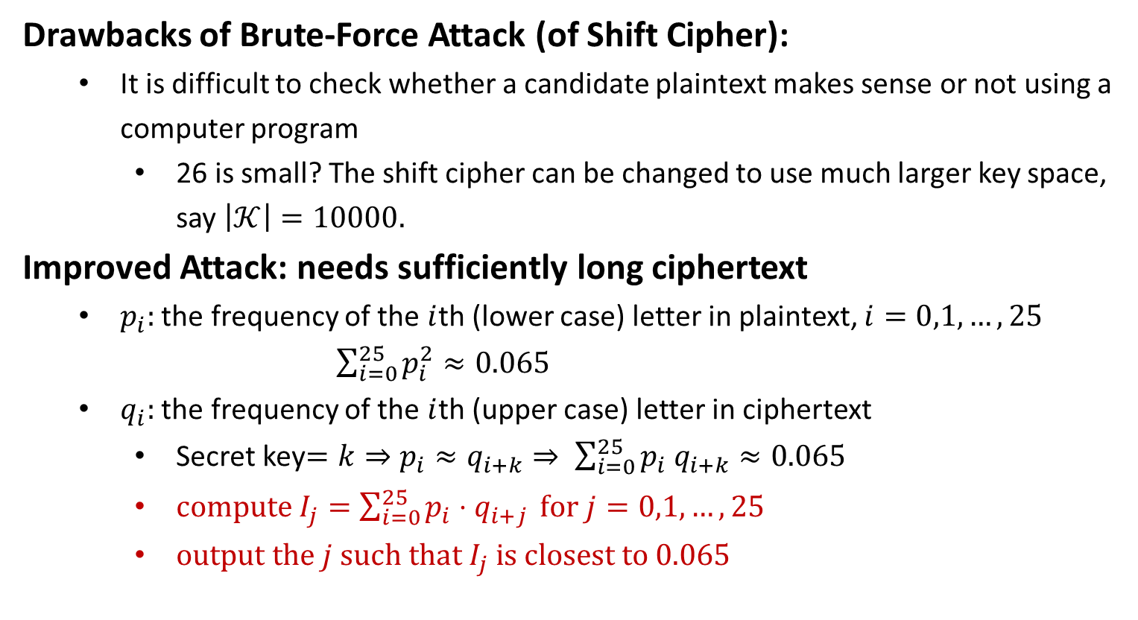
Improved Attack of Shift Cipher
Drawbacks of Brute-Force Attack (of Shift Cipher):
It is difficult to check whether a candidate plaintext makes sense or not using a computer program
26 is small? The shift cipher can be changed to use much larger key space, say $\left|𝒦\right|=10000.$
Improved Attack: needs sufficiently long ciphertext
$p_{i}:$ the frequency of the $i$th (lower case) letter in plaintext, $i=0,1,…,25$
$\sum_{i=0}^{25}{p_{i}^{2}}≈0.065$
$q_{i}:$ the frequency of the $i$th (upper case) letter in ciphertext
Secret key$=k⇒p_{i}≈q_{i+k}⇒ \sum_{i=0}^{25}{p_{i} q_{i+k}≈0.065}$
$compute I_{j}=\sum_{i=0}^{25}{p_{i}⋅q_{i+j}} for j=0,1,…,25$
$output the j such that I_{j} is closest to 0.065$

Slide 17
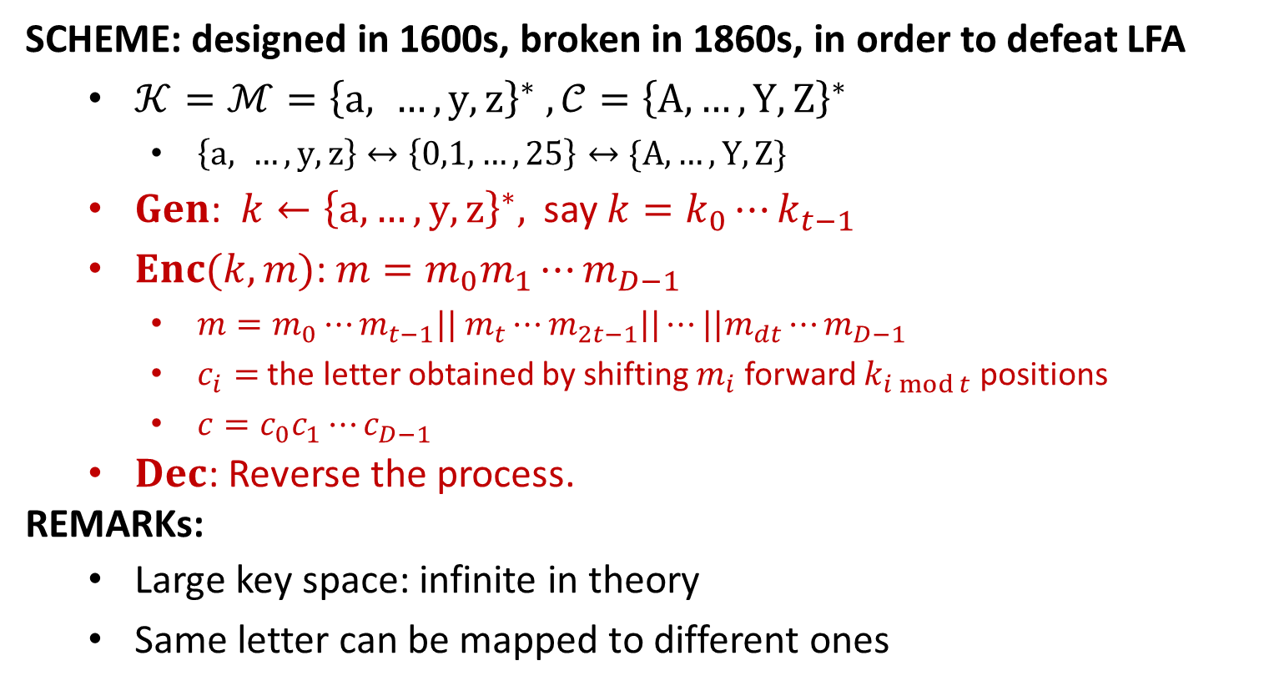
Vigenère Cipher
SCHEME: designed in 1600s, broken in 1860s, in order to defeat LFA
$𝒦=ℳ={\left\{a, …, y, z\right\}}^{∗} , 𝒞={\left\{A,…,Y,Z\right\}}^{∗}$
$\left\{a, …, y, z\right\}↔\left\{0,1,…,25\right\}↔\{A,…,Y,Z\}$
$Gen$: $k←{\left\{a,…,y,z\right\}}^{∗},$ say $k=k_{0}⋯k_{t−1}$
$Enc(k,m)$: $m=m_{0}m_{1}⋯m_{D−1}$
$m=m_{0}⋯m_{t−1}|| m_{t}⋯m_{2t−1}||⋯||m_{dt}⋯m_{D−1}$
$c_{i}=$ the letter obtained by shifting $m_{i}$ forward $k_{i mod t}$ positions
$c=c_{0}c_{1}⋯c_{D−1}$
$Dec$: Reverse the process.
REMARKs:
Large key space: infinite in theory
Same letter can be mapped to different ones

